Slide 1

UK TRAIN RIDES
Team Members
-Mohamed Alaa ( Team Leader ) -Abd El Rahman Maher
-Ziad Mohamed -Aya Anwar -Amira Atef
-Seif Marzouk
Date: 17/5/2025
17/5/24
1

Slide 2
Executive summary
Analyzing UK train ride data to:
Optimize revenue
Enhance operational efficiency
Improve passenger satisfaction
Focus on ticket pricing, delays, and route profitability
17/5/24
2

Slide 3
Business Problem
Challenges Faced:
Unpredictable passenger demand
Revenue fluctuations
Frequent delays and refunds
Lack of data-driven strategies
17/5/24
3

Slide 4
Project Objectives
Identify drivers of revenue and sales.
Analyze the impact of delays.
Assess route profitability.
Recommend strategies for pricing and customer retention.
17/5/24
4

Slide 5
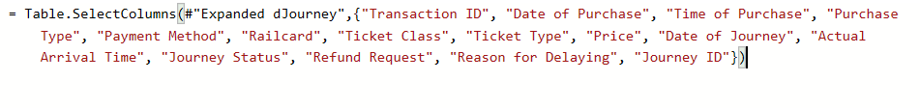
Methodology Overview
Data Sources: E Youth, Eng. Sherihan Ali
Data Cleaning: Handled missing values, corrected categories.
Tools: Power BI, Excel
Techniques: Descriptive and diagnostic analytics, DAX for KPIs.
17/5/24
5

Slide 6
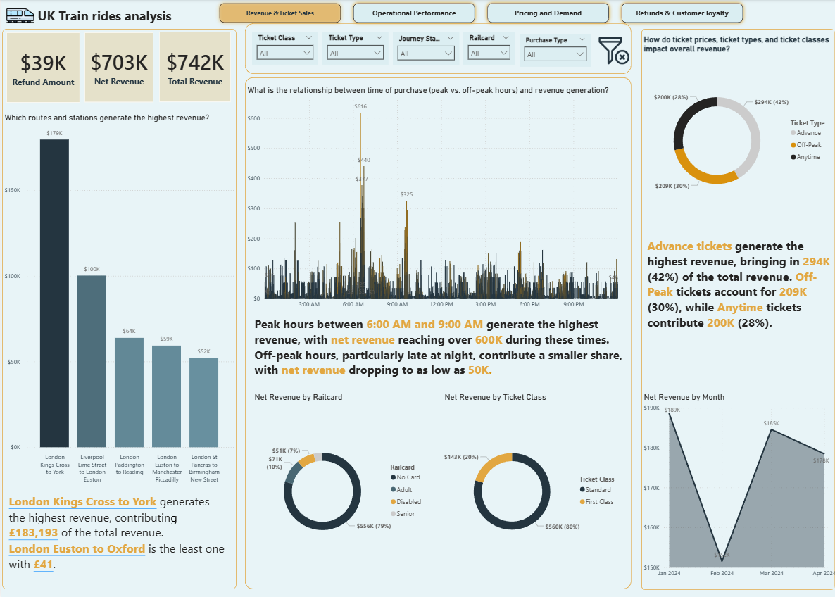
Power BI Dashboard Overview
Interactive visuals:
Revenue trends
Delay analysis
Refund patterns
Route profitability
17/5/24
6

Slide 7
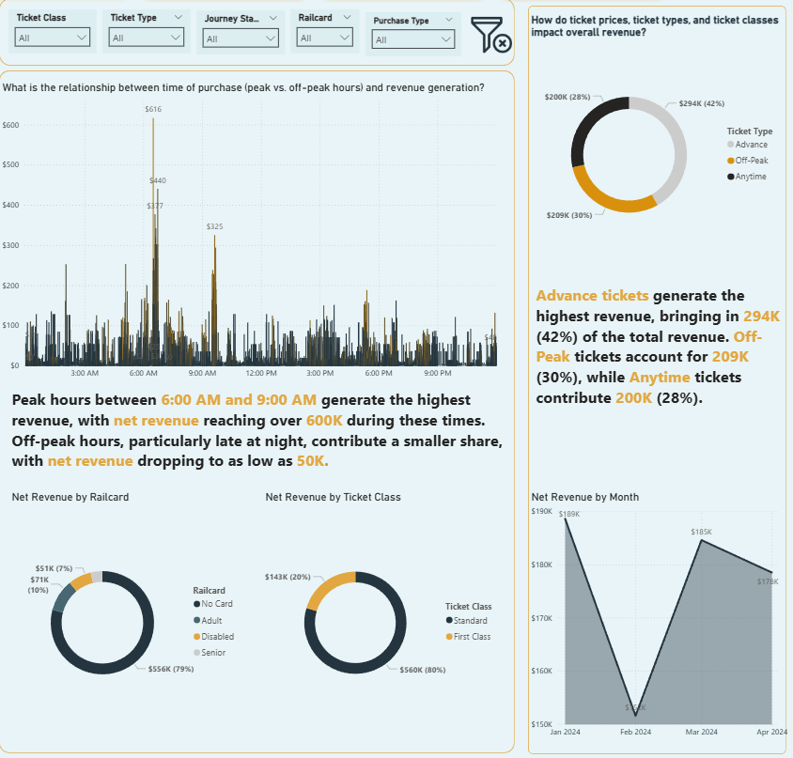
Revenue Analysis (RQ1)
Advance tickets: 42% of revenue (£294k).
Peak hours (6–9 AM): £600k revenue.
Late-night rides: Only £50k.
Insight: Need dynamic off-peak pricing.
17/5/24
7

Slide 8
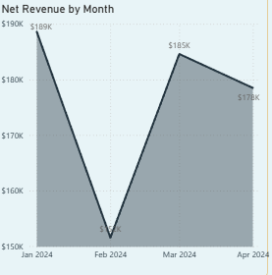
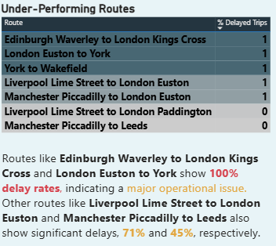
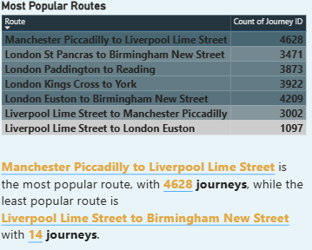
Route Profitability (RQ3)
Underperforming Route: Edinburgh Waverly → London Kings Cross Street (£52k).
Highest journey count: Manchester → Liverpool (4628 journeys).
Top Route: London Kings Cross → York (£179k).
17/5/24
8

Slide 9
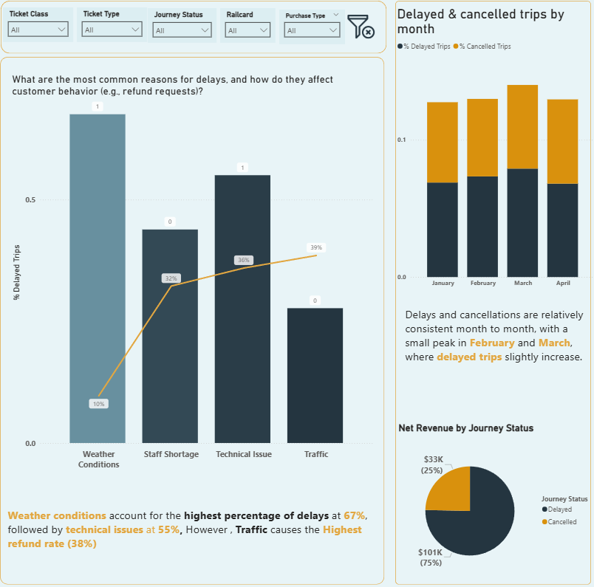
Delay Analysis (RQ2)
On-Time Performance:
86.82%.
Main delay causes:
Weather (67%)
Technical issues (55%)
Staff shortages (30%)
Refund rate:
3.53% (£39k).
17/5/24
9

Slide 10
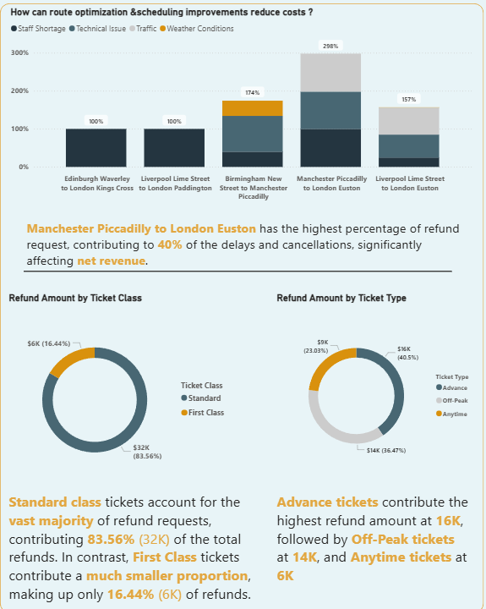
Refunds & Customer Loyalty (RQ5)
Standard Class: 83.62% of refunds.
First Class: 16.44% of refunds.
Insights : Improve Standard Class reliability.
10

Slide 11
Trends & Anomalies
Revenue peaks in January.
Peak-hour dominance (80% of daily revenue).
100% delay on Edinburgh Waverley → London Kings Cross route.
Advance ticket high refund rate despite high revenue.
17/5/24
11

Slide 12
Recommendations
Dynamic pricing for Advance tickets.
Loyalty programs for Standard class.
Staff allocation for delay-prone routes.
Predictive maintenance.
Real-time updates for delays.
Route-based promotional strategies
17/5/24
12

Slide 13
Conclusion
Objectives successfully achieved.
Estimated improvements:
Revenue increase: 10–15%.
Refund reduction: 20%.
Power BI dashboard supports data-driven decision-making.
17/5/24
13

Slide 14
Thank you,
Kindly waiting for your feedback.
17/5/24
14

